Slide 1
Anticipez les besoins en consommation électrique de bâtiments
ALI JAFFAR
06/01/2021

Slide 2
Overview and context
Data presentation
Data preprocessing
Data Exploration
Modelisation & Prediction : Supervised learning
Result evaluations
Impact of energy start_score
Conclusion
01
02
03
04
05
06
07
08
Plan

Slide 3

Overview and context
01

Slide 4

Problématique de la ville de Seattle
objectif de ville neutre en émissions de carbone en 2050, on s'intéresse de près aux émissions des bâtiments non destinés à l’habitation. tenter de prédire les émissions de CO2 et la consommation totale d’énergie de bâtiments pour lesquels elles n’ont pas encore été mesurées.
Lien des donnees de 2015 et 2016:
https://www.kaggle.com/city-of-seattle/sea-building-energy-benchmarking#2015-building-energy-benchmarking.csv
prédiction se basera sur les données déclaratives du permis d'exploitation commerciale (taille et usage des bâtiments, mention de travaux récents, date de construction..) et la relation avec le ENERGY STAR Score
Mission
Réaliser une courte analyse exploratoire.
Tester différents modèles de prédiction afin de répondre au mieux à la problématique.
attention à la fuite de données)
Mets en place une évaluation rigoureuse des performances de la régression, et optimise les hyperparamètres et le choix d’algorithme de ML à l’aide d’une validation croisée.
Faire attention au traitement des différentes variables, à la fois pour trouver de nouvelles informations et optimiser les performances en appliquant des transformations simples aux variables (normalisation, passage au log, etc.).
Notes:
Modifie le contex a partir de open class room

Slide 5
Data Presentation
02

Slide 6
Plan
Détaillé
Overview and context
Data presentation
Data preprocessing
Cleaning
Data aggregation
Imputation
Data Exploration
Univariate analysis
Multivariate analysis
Modelisation & Prediction : Supervised learning
Molisation:
Data Standardisation
Numeric data : Standard scaler & log transformation
Categorical data : One hot encoder
Feature Engennering
Prediction
Definition ( of the models)
Models
KNN
Linear regression
Adaboost
…..
Cross validation & hyperparameter selections
Result evaluations
Impact of energy start_score
Conclusion
Notes:
C’est quoi regrssion linear contre le ridge
dimensional reduction, c’est quoi savoir
Fot reformuler definir la problematicque d livrare a rendre et le travail a faire c’est pas le meme

Slide 7
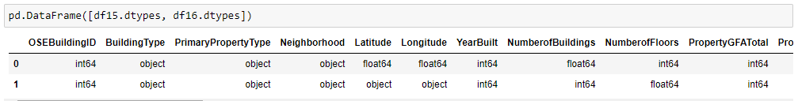
COMPARE THE COLUMNS
Data Cleaning and imputing
See the 2 datas and compare
Rename both data columns to have the same titles
Drop columns of data that are not currently relevant
See both data types in superposed so we can convert them to the same type:
Rename all columns to be simpler to follow
See “building type” unique values so we can Rename some that are similar
Keep only “non residentiel” columns
Convert any negative numbers , because it may be a simple human error
Remove columns that are no longer valuable

Slide 8
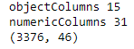
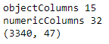
Data frame data
Data Cleaning and imputing
shape
df15
Different Features
2 dataset
Target Variable:
Emission
Energy Usage
Shape
df16
Different Features

Slide 9
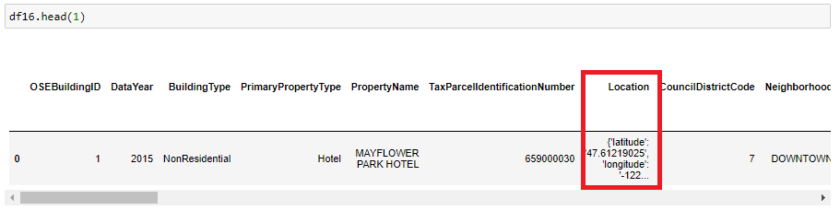
Difference between each Dataframe
Data Cleaning and imputing
It shows that the columns do have the same title but the content it not written the same way
This data shows that some of the data In df 16 the location hold the latitude , longitude , address that DF15 has. We will extrapolate them
See what is in the data of the column

Slide 10
Data preprocessing
03

Slide 11
Data aggregation
Cleaning
Imputation
a.
b.
c.

Slide 12
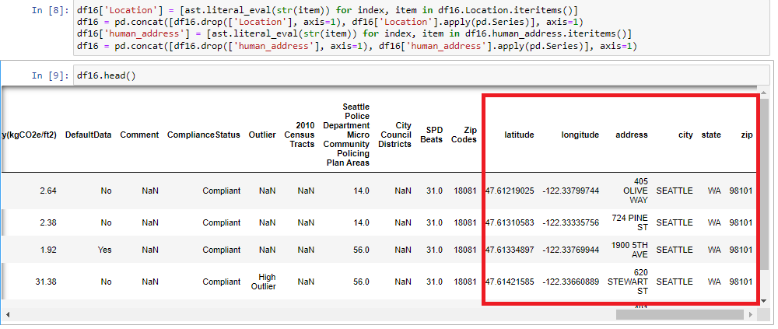
Data aggregation
In df 16 the location hold the latitude , longitude , address that DF15 has. We will extrapolate them
See what is in the data of the column
Notes:
C’est quoi regrssion linear ( is normal ) contre le ridge ( regulariesed )
dimensional reduction, c’est quoi savoir
Fot reformuler definir la problematicque d livrare a rendre et le travail a faire c’est pas le meme

Slide 13
Data Cleaning and imputing
Combination of the 2 datas
Rename all columns that are the same but written differently
Keep Categories in the row “Building Type”that we need: 'CAMPUS','NONRESIDENTIAL','NONRESIDENTIAL COS','SPS-DISTRICT K-12'
Remove any Doubles
Convert negative data into positive data
Dropping columns that we do not need : "Site_EUIWN_SF","Source_EUI_SF","Source_EUIWN_SF","SiteEnergy_UseWN_total"
Create virtual datas with formulas and replace original data if it’s there’s more than 10% difference from the virtual data. ( Parking, building GFA,SiteEnergy_Use_total, Emissions_CO2e,
Dropping all virtual columns that we no longer need
See the difference rows missing on DF 16 from DF15 and transfer those rows to DF16
Fill all NA of DF16 with DF 15
Use KNN imputer to fill the rest of the Data
Notes:
C’est quoi regrssion linear contre le ridge
dimensional reduction, c’est quoi savoir
Fot reformuler definir la problematicque d livrare a rendre et le travail a faire c’est pas le meme

Slide 14
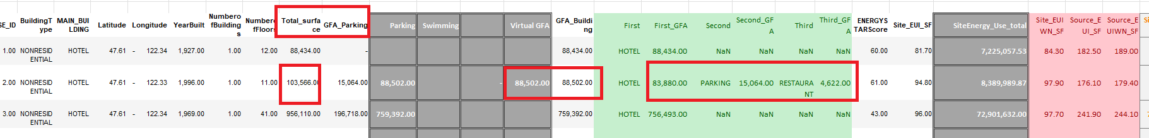
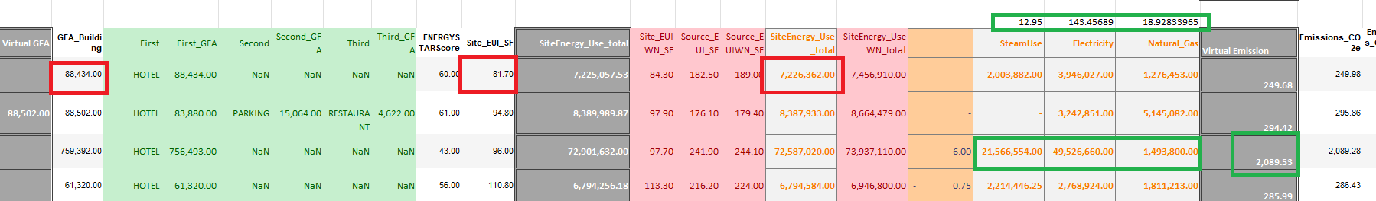
Virtual Data
We discover that the Parking did not produce any energy usage because the calculator for the GFA is done after removing the Parking.. The make sure the data stays as relevant as possible. We had to search all the column that hold a Parking and added it in a virtual column.
Building, Site energy use total, Emissions:
They followed each separate formula
GFA building = total land surface - Parking surface
Site Energy usage = building size * energy per square foot
We can find the emission in the internet
Total emissions = (Steam /12.95 + electricity/143.45689 + Gas/ 18.92833965) /1000
Compared each columns with there virtual columns I have created current parking available with the parking we found, then replace it if there’s a 10% difference
Remove all columns that are 90% empty , it means something we can’t fill with
Notes:
Compare les building type so see if it consume energy and remove them for the calculation

Slide 15
Data Exploration
04

Slide 16
Univariate analysis
Multivariate analysis
a.
b.

Slide 17
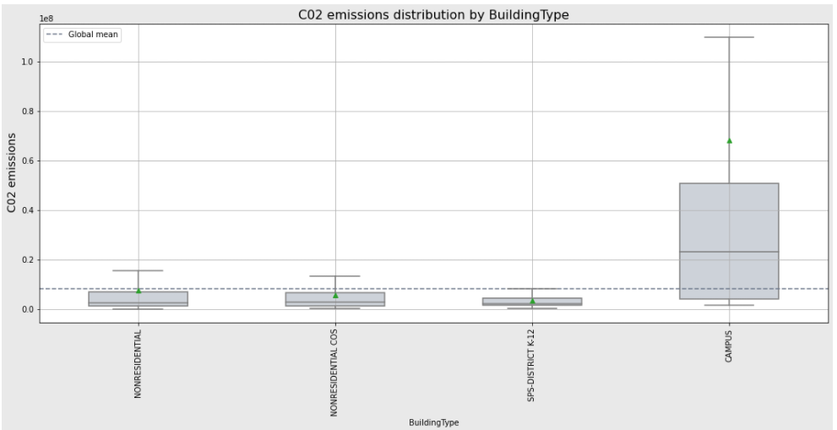
We see that the emission a almost all similar except the campus
Univariate analysis

Slide 18
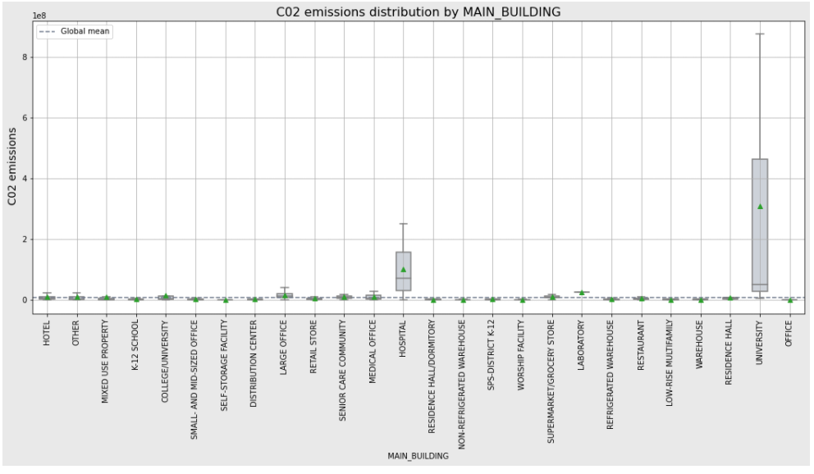
We see deeper that all building do follow the same emission trend expect the hospital and university
Univariate analysis

Slide 19
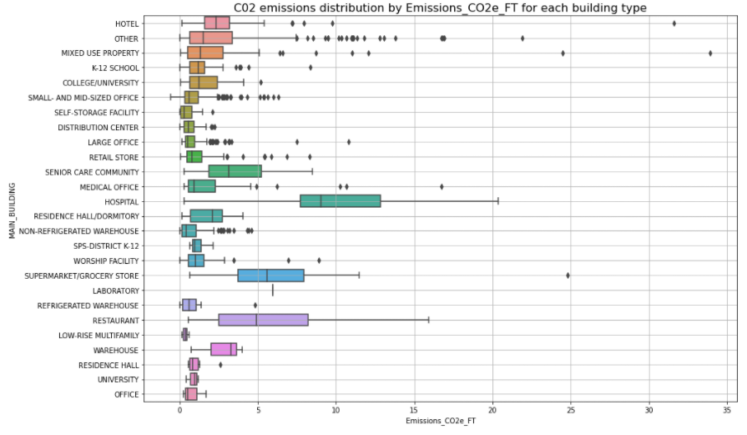
But if we see the data per SF we see that not all follow the same tred so it’s better to aim in a global view
Univariate analysis

Slide 20
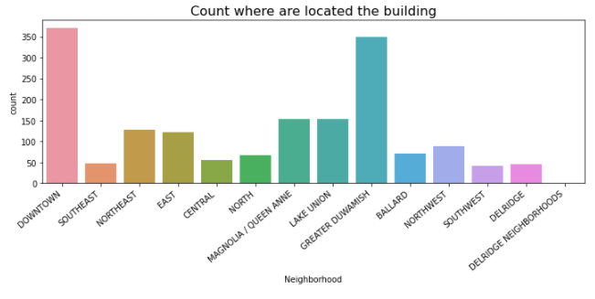
This shows that the most building are located in downtown and Greater Duwamish
Univariate analysis

Slide 21
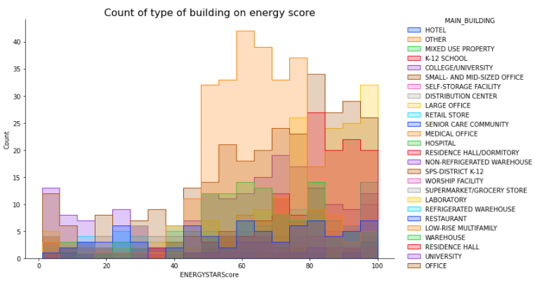
Univariate analysis

Slide 22
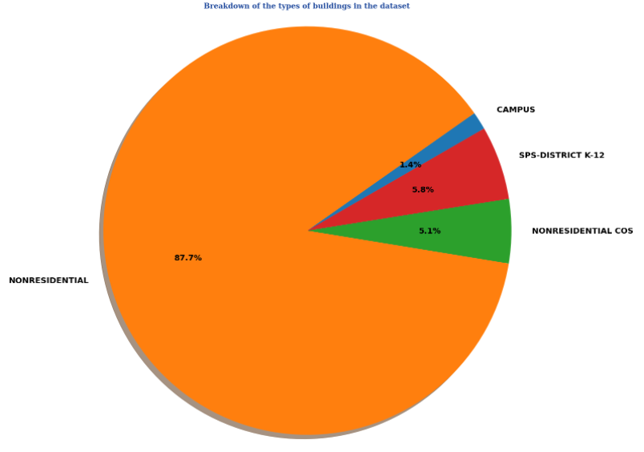
Univariate analysis
Notes:
Put title on the side
Put the description
Put same size box

Slide 23
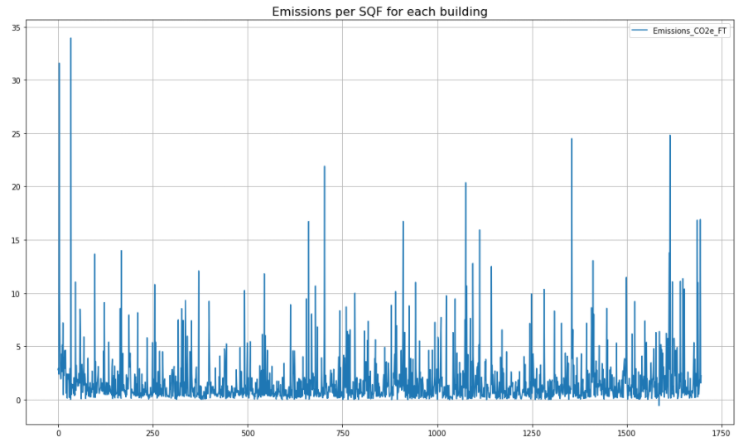
Univariate analysis

Slide 24
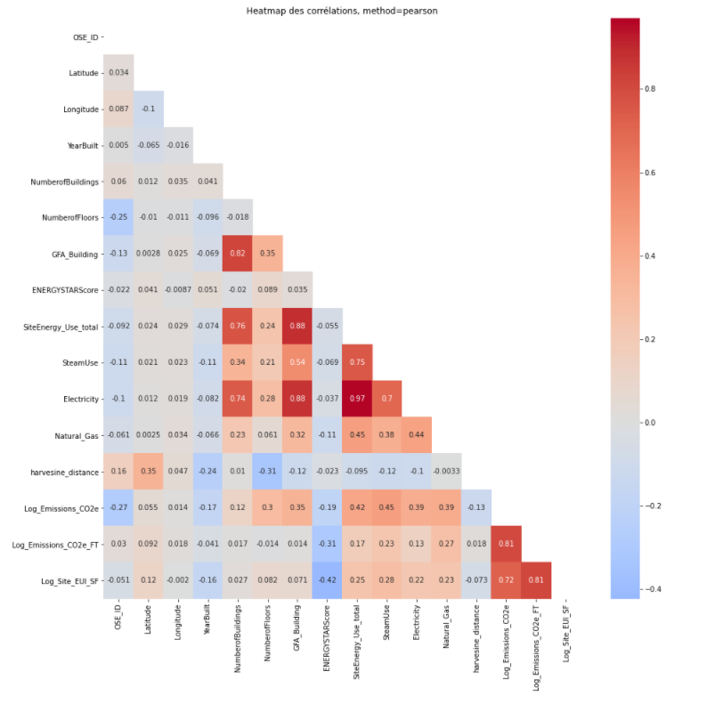
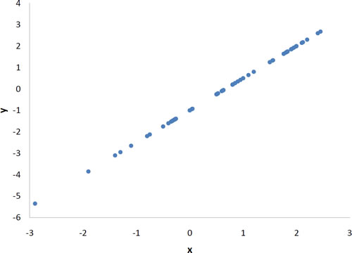
Pearson
Multivariate analysis
Pearson : Measures the strength and direction of a Linear association association between to variable
Example:

Slide 25
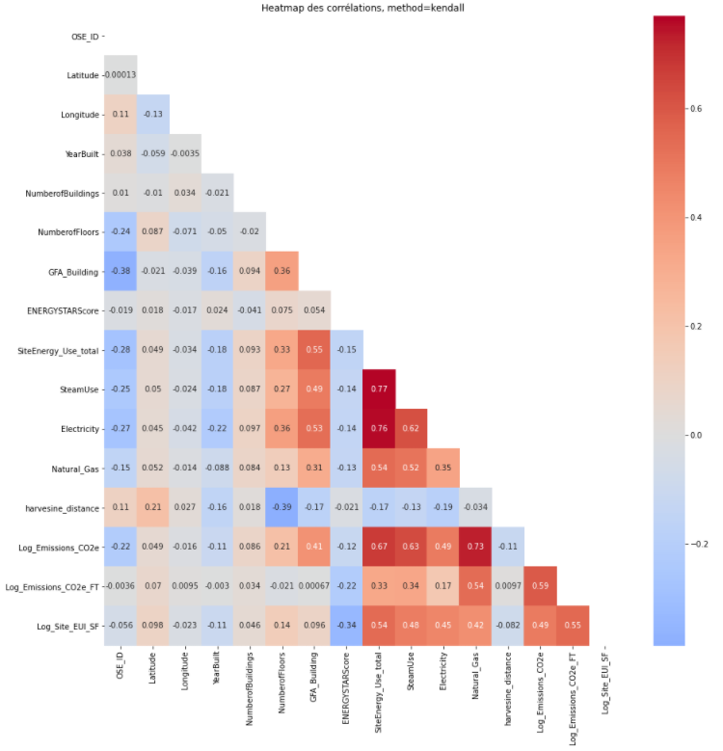
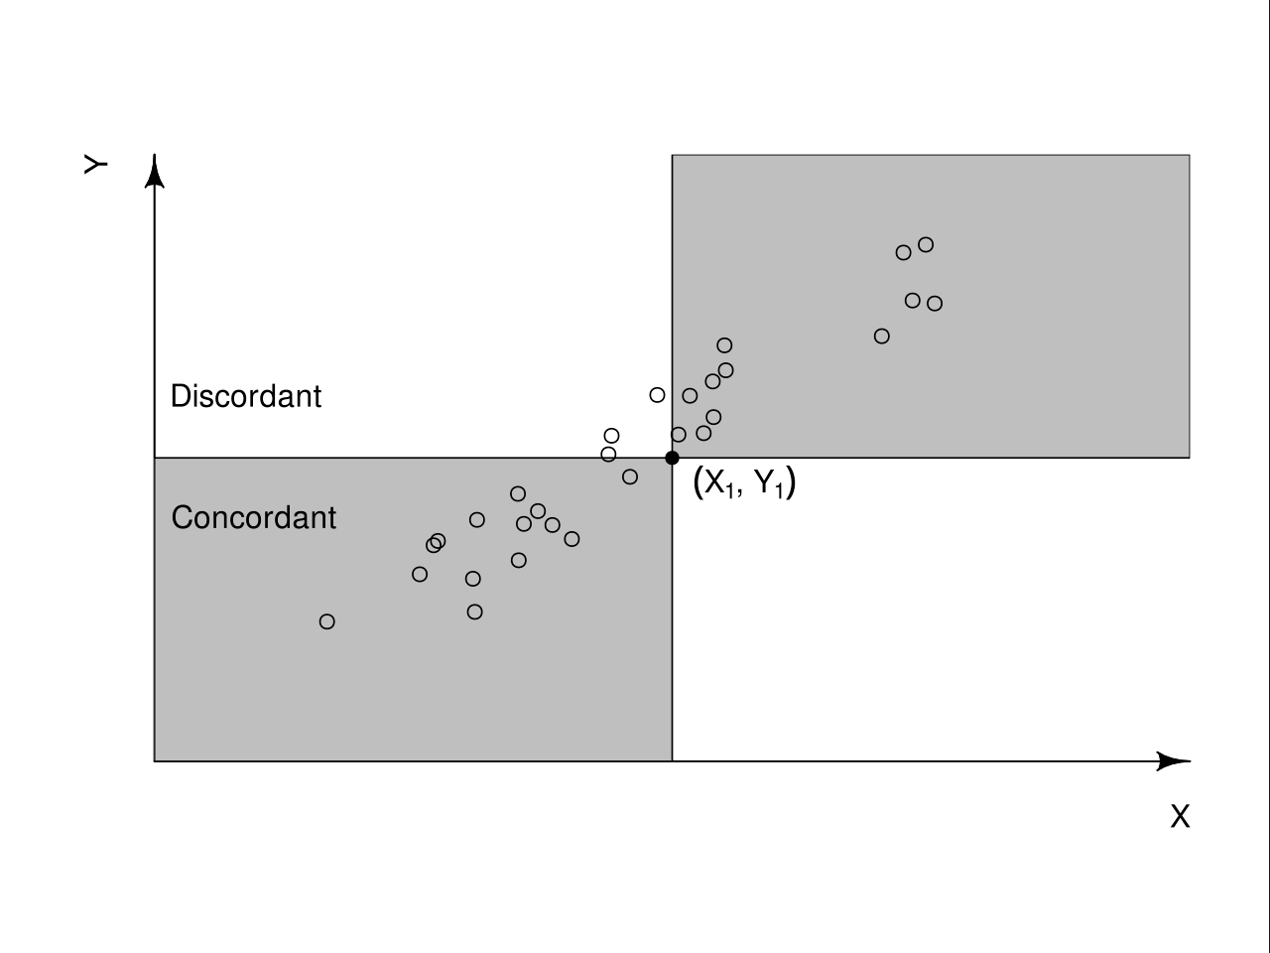
Kendal
Multivariate analysis
Kendall’s Tau is a non-parametric measure of relationships between columns of ranked data. The Tau correlation coefficient returns a value of 0 to 1, where:
0 is no relationship,
1 is a perfect relationship.
A quirk of this test is that it can also produce negative values (i.e. from -1 to 0). Unlike a linear graph, a negative relationship doesn’t mean much with ranked columns (other than you perhaps switched the columns around), so just remove the negative sign when you’re interpreting Tau.
Several version’s of Tau exist.
Tau-A and Tau-B are usually used for square tables (with equal columns and rows). Tau-B will adjust for tied ranks.
Tau-C is usually used for rectangular tables. For square tables, Tau-B and Tau-C are essentially the same.
Notes:
Ca c’est univarie
Expliquer la difference

Slide 26
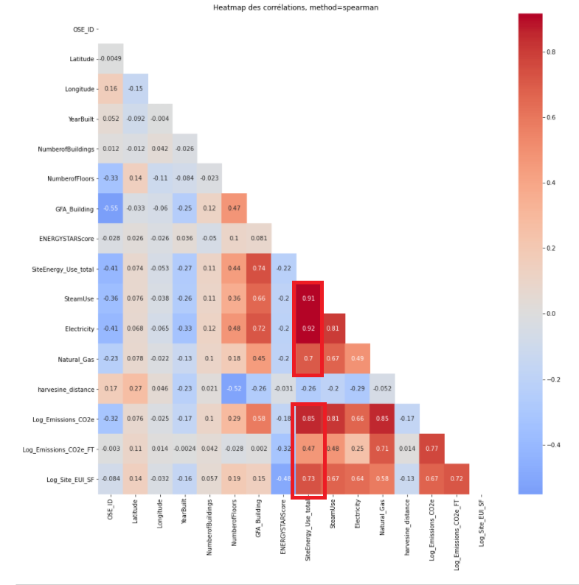
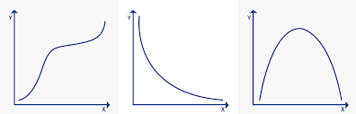
Spearman
Multivariate analysis
Spearman is the perfect correlation because it does prove my hypothesis that Steam , electricity, Natural gas have a direct influence on the Site_energy_total.
By using Spearman it does show that the Emission_CO2_FT and the Log_Site_EU_SF has a strong correlation as well.
This mean we need to remove them because this will eventually cause a data leakage.
Spearman: Measures the strength and direction of a monotonic association between to ranked variable
This formula is applied in cases when there are no tied ranks. However, in the case of fewer numbers of tied ranks, this approximation of Spearman’s rank correlation coefficient provides sufficiently good approximations.
Key terms:
Non-parametric test: it does not depend upon the assumptions of various underlying distributions; this means that it is distribution free.
Concordant pairs: if both members of one observation are larger than their respective members of the other observations
Discordant pairs: if the two numbers in one observation differ in opposite directions

Slide 27
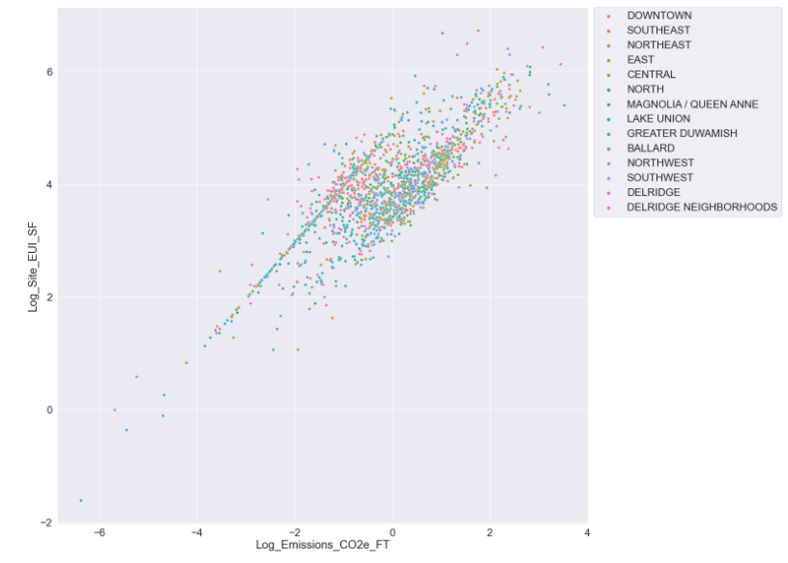
The graph shows that the Square foot and the emission square foot are following a linear regression .
Multivariate analysis

Slide 28
Modelisation & Prediction : Supervised learning
05

Slide 29
Molisation:
Data Standardisation
Numeric data : Standard scaler & log transformation
Categorical data : One hot encoder
Feature Engennering
Prediction
Definition
Models
KNN
Linear
Ridge
Bayesian Ridge
Lasso
Bagging
Random Forest
Adaboost
SVM RBF
Regression
Cross validation & hyperparameter selections
Notes:
Rendre plus simple
Modefier le plant

Slide 30
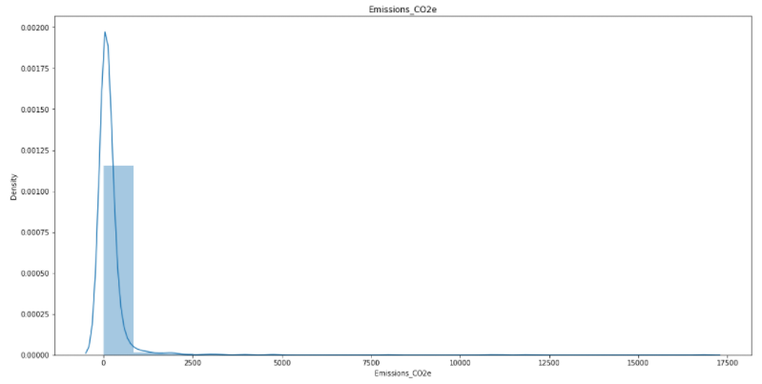
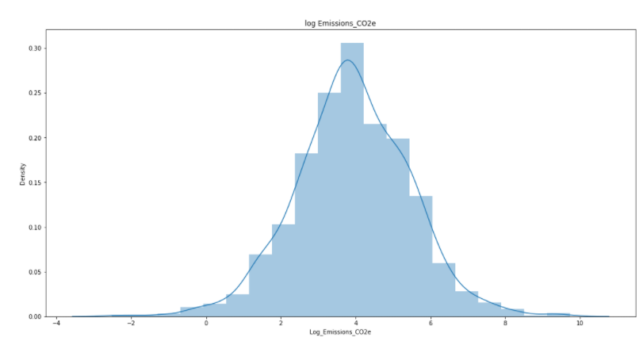
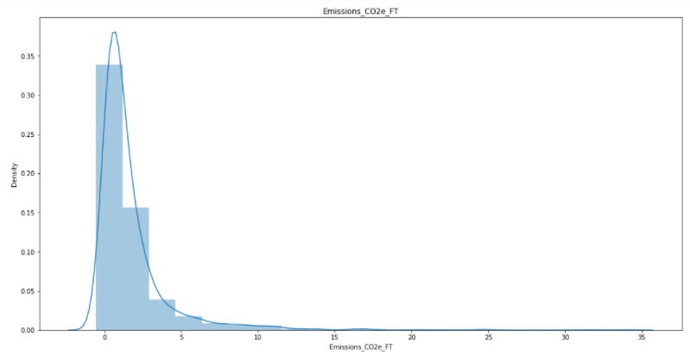
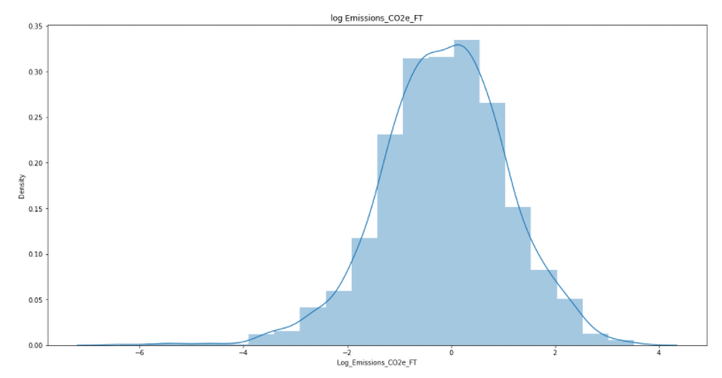
Before and After LOG
Data Standardisation
Notes:
Standartization titres

Slide 31
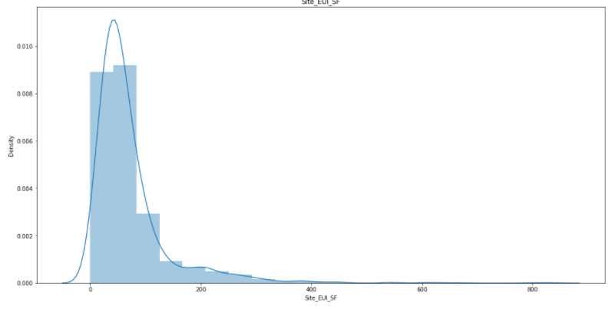
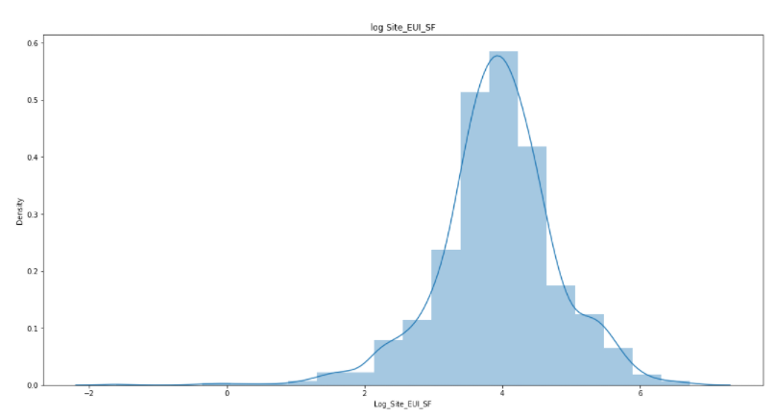
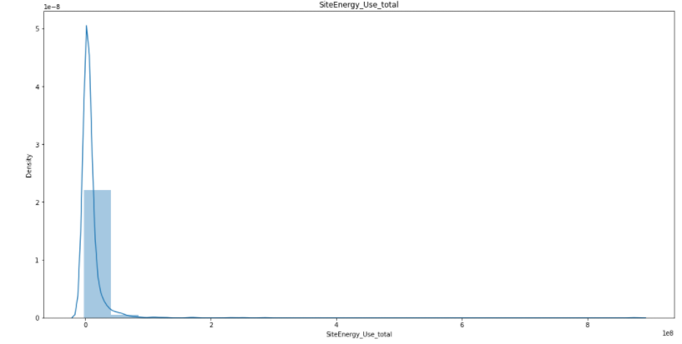
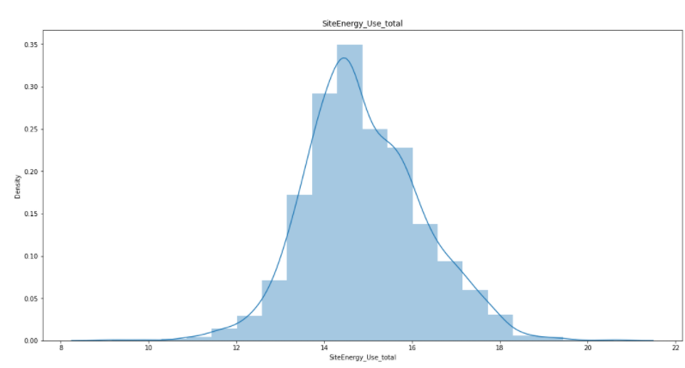
Before and After LOG
Data Standardisation
Notes:
Standartization titres
AGRANDIRE LES TITRES

Slide 32
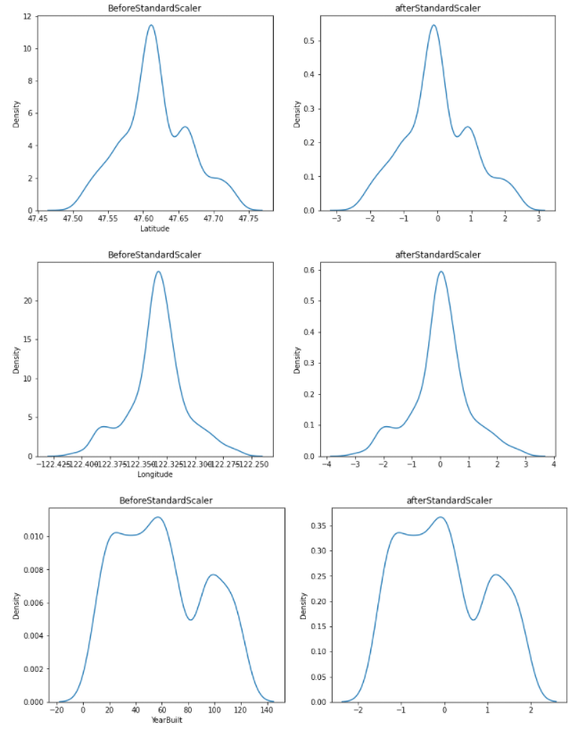
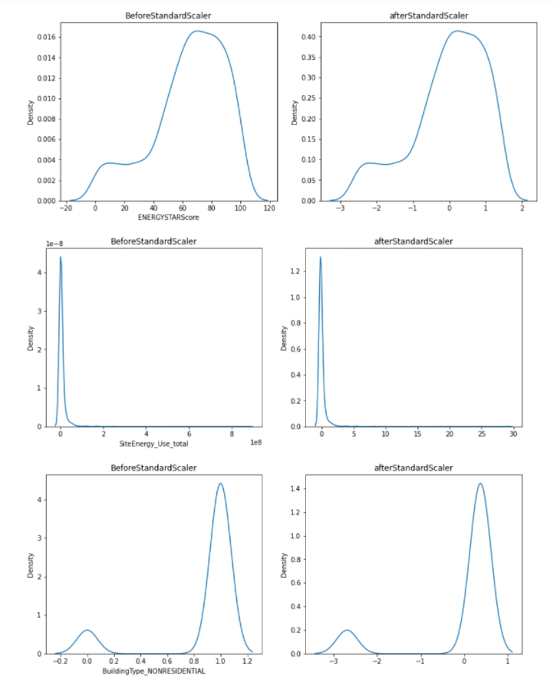
Before and After Standard Scaler
Data Standardisation
Notes:
Standartization titres
AGRANDIRE LES TITRES

Slide 33
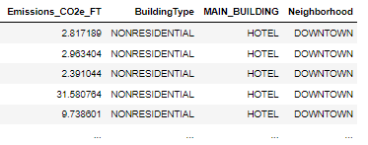
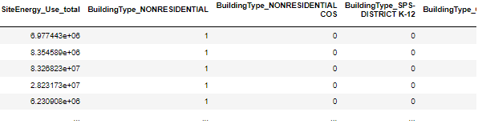
One hot encoder :
One-hot Encoding is a type of vector representation in which all of the elements in a vector are 0, except for one, which has 1 as its value, where 1 represents a boolean specifying a category of the element.
Feature Engeriging
Notes:
Arrange les taill edes titres

Slide 34
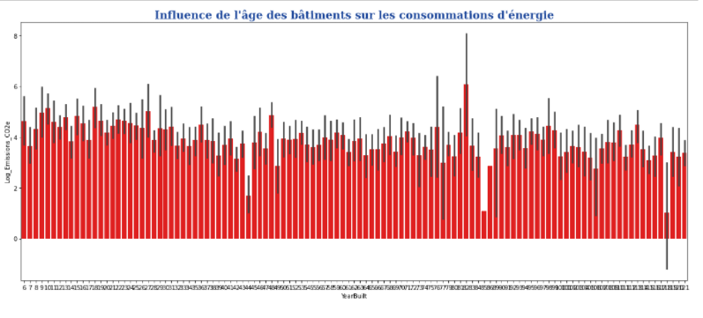
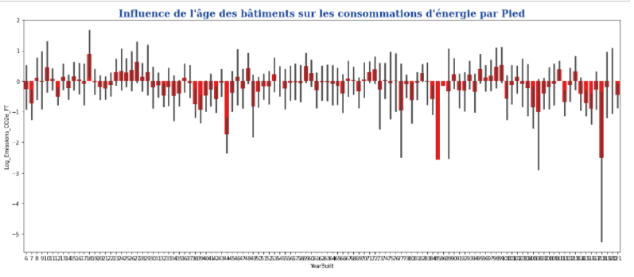
Feature Engeriging
Notes:
Supprimer

Slide 35
Definition:
Linear: (in scikit-learn) is the most basic form, where the model is not penalized for its choice of weights, at all. That means, during the training stage, if the model feels like one particular feature is particularly important, the model may place a large weight to the feature. This sometimes leads to overfitting in small datasets. Hence, following methods are invented.
Ridge: takes a step further and penalizes the model for the sum of squared value of the weights. Thus, the weights not only tend to have smaller absolute values, but also really tend to penalize the extremes of the weights, resulting in a group of weights that are more evenly distributed. :
Bayesian Ridge :Bayesian linear regression allows a useful mechanism to deal with insufficient data, or poor distributed data. It allows you to put a prior on the coefficients and on the noise so that in the absence of data, the priors can take over.
Lasso : is a modification of linear regression, where the model is penalized for the sum of absolute values of the weights. Thus, the absolute values of weight will be (in general) reduced, and many will tend to be zeros. During training, the objective function become:
Bagging: A Bagging classifier is an ensemble meta-estimator that fits base classifiers each on random subsets of the original dataset and then aggregate their individual predictions (either by voting or by averaging) to form a final prediction. ... If samples are drawn with replacement, then the method is known as Bagging
Random Forest :A random forest is a meta estimator that fits a number of classifying decision trees on various sub-samples of the dataset and uses averaging to improve the predictive accuracy and control over-fitting. The sub-sample size is controlled with the max_samples parameter if bootstrap=True (default), otherwise the whole dataset is used to build each tree.
Adaboost: An AdaBoost [1] regressor is a meta-estimator that begins by fitting a regressor on the original dataset and then fits additional copies of the regressor on the same dataset but where the weights of instances are adjusted according to the error of the current prediction. As such, subsequent regressors focus more on difficult cases.
SVM RBF: support vector Mahine: Gaussian RBF(Radial Basis Function) is another popular Kernel method used in SVM models for more. RBF kernel is a function whose value depends on the distance from the origin or from some point
KNN: is a non-parametric method that, in an intuitive manner, approximates the association between independent variables and the continuous outcome by averaging the observations in the same neighbourhood. The size of the neighbourhood needs to be set by the analyst or can be chosen using cross-validation (we will see this later) to select the size that minimises the mean-squared error.
Prediction
Notes:
Arrange les taill edes titres

Slide 36
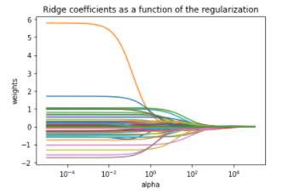
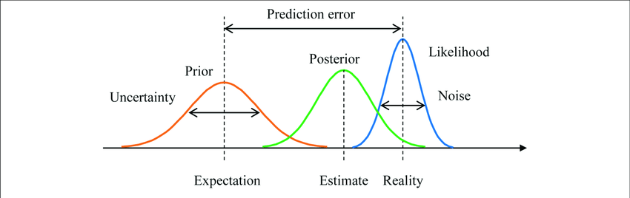
See prediction Value
See the Prediction Value :
Starting with one Hot encoder that will help us use the columns that are in objects and convert them into variable in separate columns
Use prediction Models to predict the Emission
Linear
Simple regression that will draw line
Ridge
It is a Linear regression but It is Regularized (or regularized regression)
Coefficient Of linear Regression are not equal to zero if there column is not contributing
Ridge Regression makes columns that are not important to Zero or equal to zero or very small so that contribution is very less in Prediction So it will reduce overall variance in our model
Notes:
Presenter les model et expliquer

Slide 37
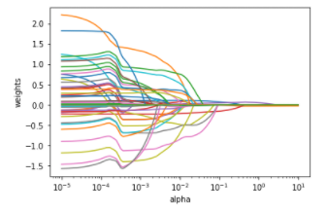
See prediction Value
Starting
Lasso
Lasso Regression is a popular type of regularized linear regression that includes an L1 penalty. This has the effect of shrinking the coefficients for those input variables that do not contribute much to the prediction task.
Random Forest
They are made out of decision trees, but don't have the same problems with accuracy.
Adaboost
AdaBoost is one of those machine learning methods that seems so much more confusing than it really is. It's really just a simple twist on decision trees and random forests. It uses stumps
Bagging
Bagging is an ensemble machine learning algorithm that combines the predictions from many decision trees.
Notes:
Presenter les model et expliquer

Slide 38
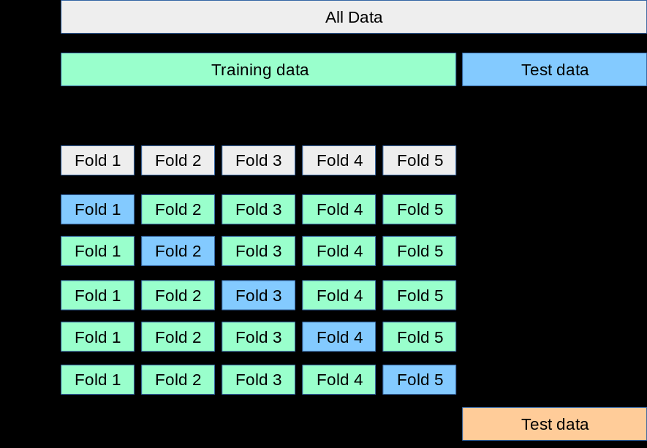
Cross validation :
Linear: (Learning the parameters of a prediction function and testing it on the same data is a methodological mistake: a model that would just repeat the labels of the samples that it has just seen would have a perfect score but would fail to predict anything useful on yet-unseen data. This situation is called overfitting.
Prediction
Notes:
Arrange les taill edes titres

Slide 39
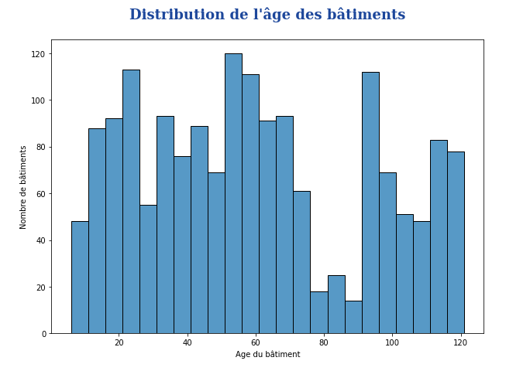
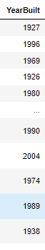
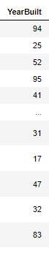
Creation of the Age column to see if the age does affect the emission of the building
Feature Engeriging
Notes:
Arrange les taill edes titres

Slide 40
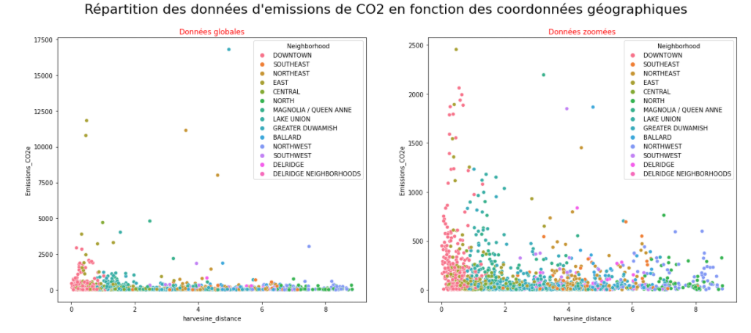
Creation of the Distance column to see if distance from the center of seattle will affect the the emission
Feature Engeriging
Notes:
Arrange les taill edes titres

Slide 41
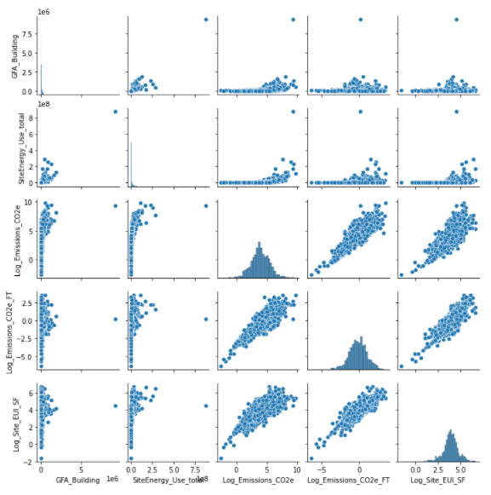
Pair plot

Slide 42
Result evaluations
06

Slide 43
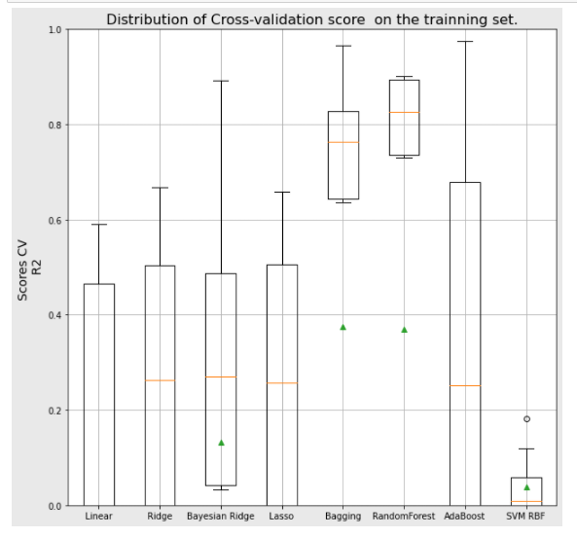
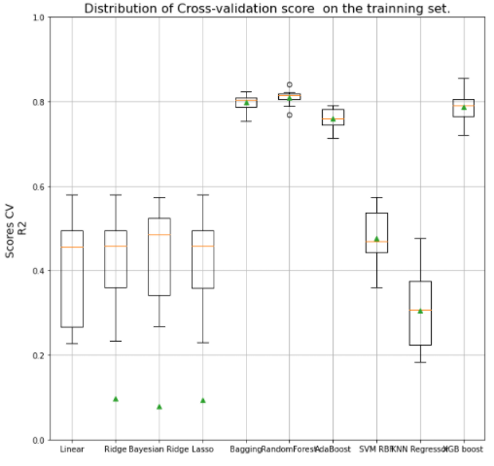
Before and After Log on the emission
Hyper Parameter
This shows that that converting the Emission into Log creates a better Prediction accuracy compare to the previous one. But both do states that the

Slide 44
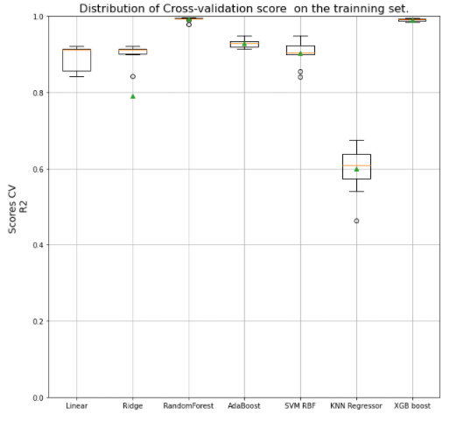
Before and After Hyper parameter optimisation
Hyper Parameter

Slide 45
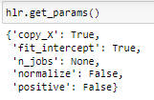
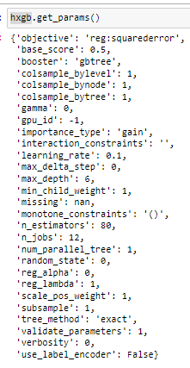
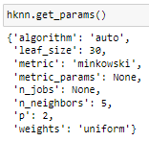

Hyper Parameter
After selecting the best option for our prediction model. We will now select the best hyper Parameters that fits perfectly. We will use a grid search to find the best option
Linear: Xgboost:
KNN: Ridge:

Slide 46


Hyper Parameter
Adaboost: Random Forest :

Slide 47


Before and After Log on the emission
It shows the Log did remove most weight of most Columns and centrilise it into some selected few. And gave them more weight

Slide 48


Before and After Log on the emission
With log it did increase the prediction model to be linear and with higher accuracy rate

Slide 49


Before and After Log on the emission
With log it did increase the prediction model to be linear and with higher accuracy rate and reduce all into the same group instead of being divided into 4 separate categories

Slide 50
Impact of energy start score
07

Slide 51


Prediction Model on the Site Energy Use Total
With Energy Score
Without Energy Score
Notes:
METTRE LES HYPER PARAMTRE

Slide 52


Prediction Model on the Emissions
With Energy Score
Without Energy Score

Slide 53
Conclusion
08

Slide 54
It clearly shows , by implementing LOG it increase the accuracy to all data by at least 10 % for energy usage and 40% for the emission
But the accurry with and without the Start Score the difference is not that different it clearly show that the Start score can be predict and categorised
Notes:
UTILLER LES PREDICITON LINEAR ET NON LIEANRE

Slide 55
END
Notes:
Hyper parameter of all model

